Slide 1
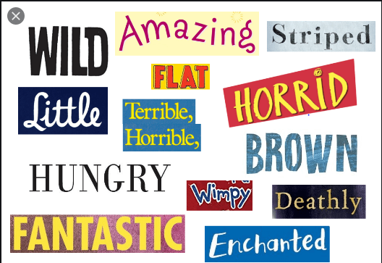
Adjectives
An adjectives is a describing word.
It adds something to the meaning of a noun or a pronoun by telling its number, colour or quality.
Examples:

Slide 2
Kinds of Adjectives
Adjectives of Quality
Adjectives of Quantity
Adjectives of Number
Demonstrative adjectives
Possessive adjectives

Slide 3
Adjectives of quality
Describe the kind , quality or characteristic
- Good, beautiful, tall, white, hot, cold etc
Adjectives of quantity
Describe quantity ,answer the question, ‘How much’ .
- some , much, all enough, half, little etc
Adjectives of number
Answer, ‘How many’ indicated number and the order of things/ persons
- One, two, many, few, first, last, etc

Slide 4
Demonstrative adjectives
Indicate which person/ thing is referred.
- This, that, these, those, such
Possessive adjectives
Indicate possession
- my, our, your, his, her , their, its

Slide 5
Fill in the blanks
The beggar was given ______________ food. ( some , any , all)
I have _______________homework to do. ( much , many , more )
There are _______________ biscuits in the box. ( few , a few, the few)

